Slide 1

Introduction to Stock Market Analysis
This presentation provides an overview of using AWS services to conduct comprehensive stock market analysis. We'll explore the objectives, architecture, and deployment of this solution, as well as discuss challenges encountered and lessons learned.
Presented by:
Sahil Wani
Prakyath Praveen Davanam
Rithvik Segu
Meghana Shivani Invilli
Guided by: Carlos Caicedo Bastidas

Slide 2
Objective
1
Leverage AWS Cloud Services
2
Data Processing
3
Gain Actionable Insights
Utilize a suite of scalable, cost-effective AWS services to power our stock market analysis capabilities.
Streamline the process of collecting, storing, and preparing stock market data for analysis.
Generate meaningful insights to inform investment strategies and decision-making.

Slide 3
Leveraging AWS Serverless Architecture
Scalability
Cost-Efficiency
Maintenance-Free
The serverless, event-driven nature of the AWS services ensures the solution can automatically scale to handle fluctuations in data volume and analysis demands.
By only paying for the resources used, the serverless architecture provides a cost-effective way to run the stock market analysis workloads.
AWS manages the underlying infrastructure, allowing the team to focus on developing and improving the analytical capabilities rather than managing servers

Slide 4

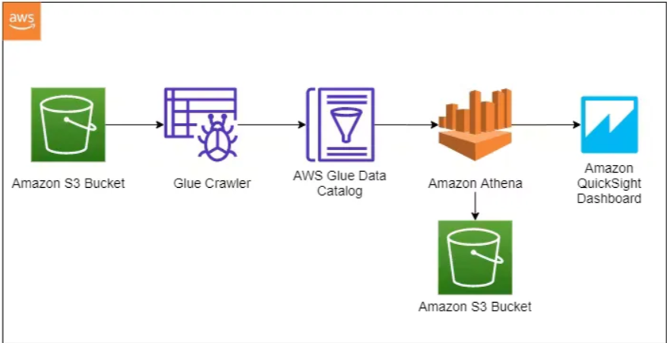
Architecture and Services Flowchart

Slide 5
Integrating the AWS Services
Data Ingestion
Data Exploration
Visualization
Use Amazon S3 to store raw stock market data, and AWS Glue to extract, transform, and load the data into a format suitable for analysis.
Leverage Amazon Athena to run SQL queries on the transformed data, allowing for interactive exploration and discovery of insights.
Employ Amazon QuickSight to create interactive, visually-appealing dashboards and reports, enabling stakeholders to easily understand and interpret the analysis.

Slide 6
Data Preprocessing
Initially, four stock market datasets from Nasdaq were obtained for companies such as Apple, Microsoft, AMD, and Qualcomm
A new column titled 'Company' was added to each dataset to specify the company name
Subsequently, these four datasets were merged to create a unified dataset
The dataset was then examined for any null or duplicate values, and outliers were identified using a box plot
Finally, the data type of the 'date' column was adjusted, and additional columns for 'quarter', 'year', and 'day' were created to enhance the analysis.

Slide 7






Deployment Procedure
Chose a new s3 bucket and uploaded the file for storage
Created a new database within AWS Glue
Set up and run a Glue Crawler to populate the Data Catalog with
metadata from the S3 bucket
Utilized Athena to execute SQL queries against the data organized in the Glue Data Catalog
Connected Quicksight to Athena to visualize and analyze the data through interactive dashboards

Slide 8
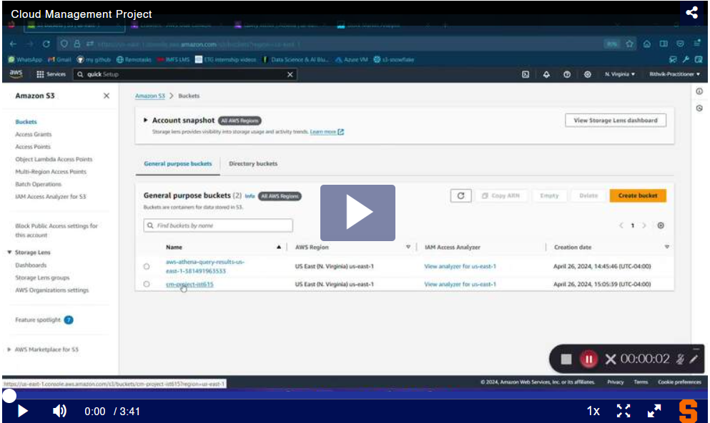
Video Demonstration
https://video.syr.edu/media/t/1_evf19lqu

Slide 9
Issues Encountered
Server Overloading: Due to its extensive resource requirements, Kafka proved to be a heavy application for our virtual machine, which could not handle the large volume of load owing to memory constraints.
Issues Creating Kafka Topics: We faced challenges while attempting to create topics within our Kafka consumer instance
Integration Issues with AWS QuickSight: The AWS Learner's Account limitations prevented us from using the AWS QuickSight service

Slide 10
Conclusion and Next Steps
1
Conclusion
2
Future Enhancements
The integration of AWS services has enabled us to create a scalable, cost-effective, and efficient stock market analysis solution.
Explore the use of AWS sagemaker for machine learning and artificial intelligence to enhance the predictive capabilities of the analysis.

Slide 11

Thank you

